Slide 1
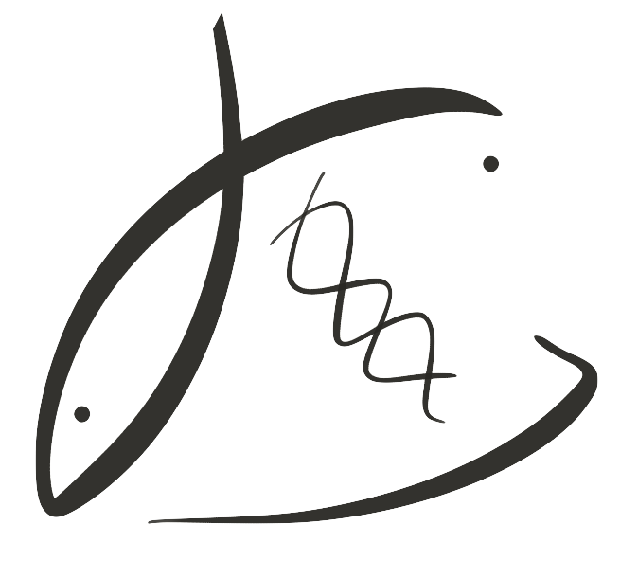



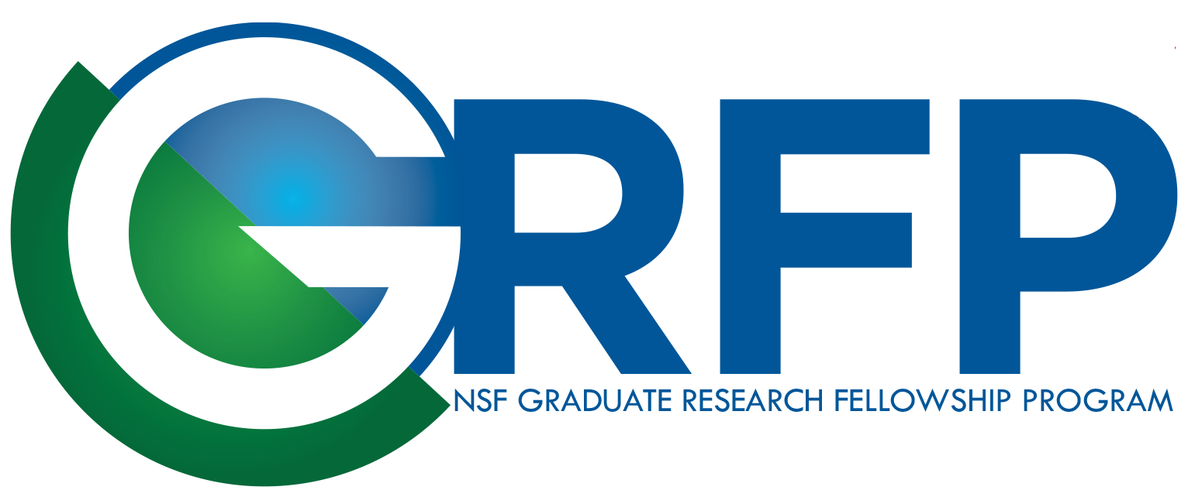

Effects of parental low pH exposure on gonadal and larval gene expression in the Olympia oyster
Laura H Spencer
Co-authors: Katherine Silliman, Steven Roberts
School of Aquatic and Fishery Sciences
University of Washington
NSA Triennial, New Orleans 2019
Notes:
Parents exposed, offspring were not

Slide 2
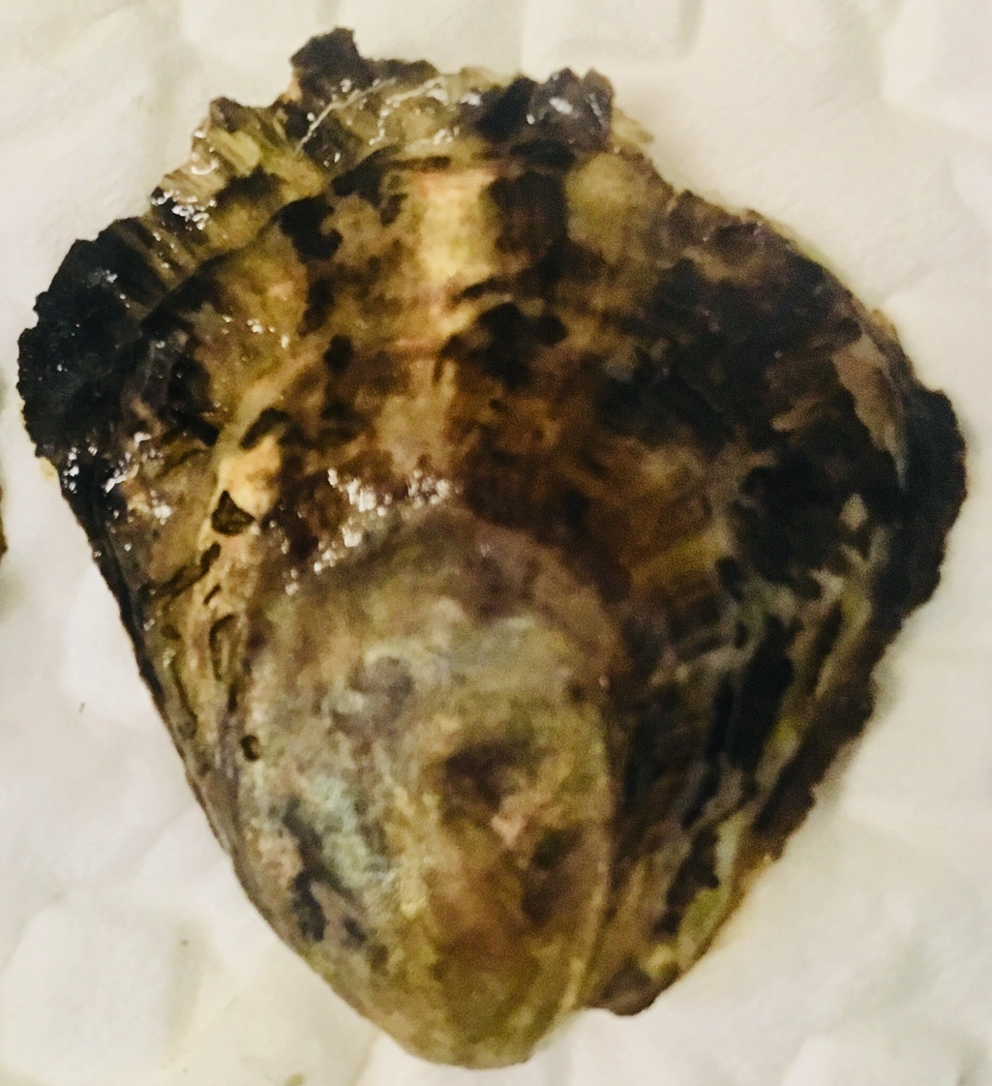
Ocean acidification, what we know
Olympia oyster – only Pacific Coast native
Negative direct effects on larvae
⬇ Larval growth, survival (Hettinger et al. 2013)
Negative carryover effects to juvenile stage
⬇ Juvenile growth after larval exposure, ⬆ Juvenile predation rate (Sanford et al. 2013, Hettinger et al. 2012)
Parental carryover effect?
Notes:
OA is a concern for calcifying marine org. around the world, but in the PNW its negative effects re already being observed in oyster hatcheries, and estuaries, specifically oyster larvae are very vulnerable.
The species that I study is the Olympia oyster,

Slide 3
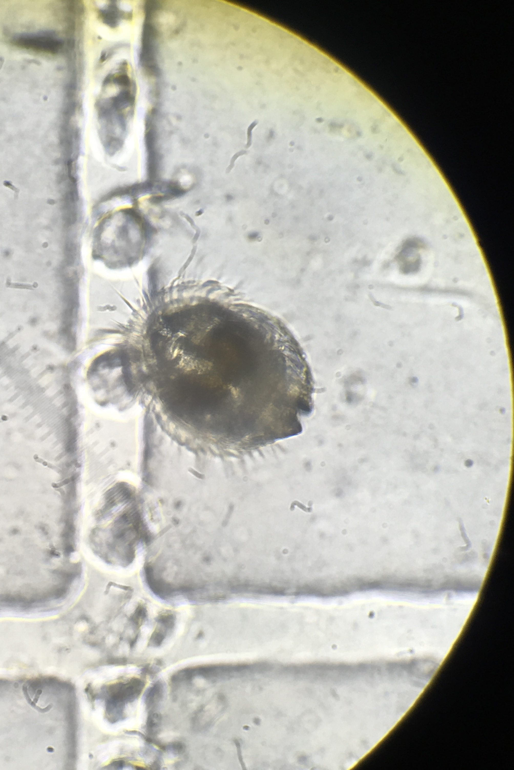

“Memory” of stress passed on to offspring?
Parental exposure can positively influence offspring response to OA (e.g. Parker et al. 2012)
This may allow oysters to quickly respond to changing ocean
Adults in pH treatment
(7 weeks, pH 7.3 & 7.8)
Adults conditioned
(4 weeks, pH 7.8)
Larvae collected
(7 weeks, pH 7.8)
Notes:
Reason why we’re interested in exploring adult exposure is that there is an exciting and optimistic theory that a parent’s exposure to stress can make the next generation more resilient to that stress.
Not just who your parents were, but what your parents and grandparents experienced.
This may allow for oysters to respond more quickly to ocean acidification, rather than relying solely on classic adaptation through gene mutation and natural selection.
(Paper: putnam 2016? Jeremias 2018? Rondon 2017?
How can larvae be more resilient to OA?
Breed for resilience

Slide 4
Parental pH exposure alters larval physiology
Parental pH
RNA sequenced using QuantSeq
Processes affected by parental pH
Aerobic respiration
Cytoskeleton
DNA repair
Translation
Protein transport
Larval survival trended lower from low pH parents, but not significant (p=0.067)
PCA Biplot, larval gene counts
Notes:
Processing that are affected – (don’t say up or down)
Focus on the fact that these oysters are not experiencing diff. environment
Is it good or bad?
Either better prepared or compromised ?
Clear evidence that the larval physiology is altered …
Should we be handling broodstock differently?

Slide 5
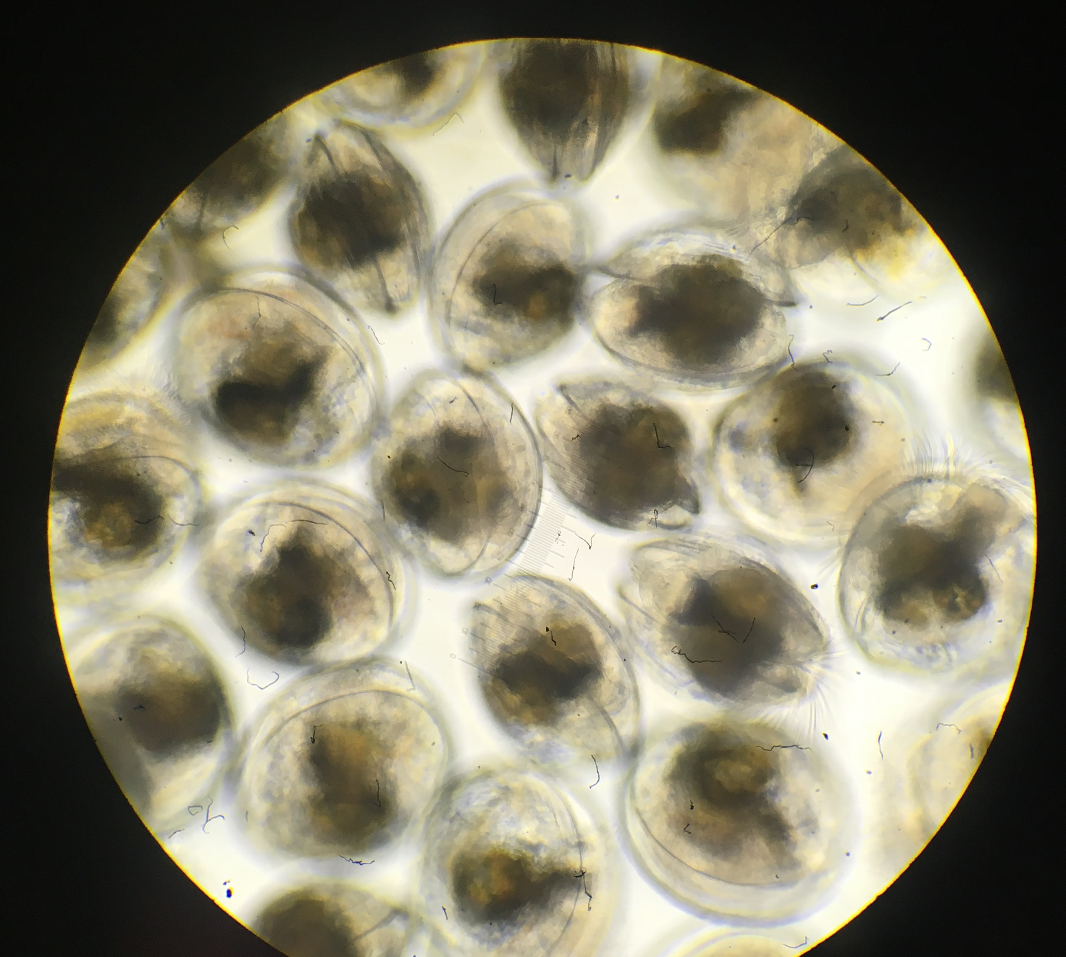
What does this mean?
Parental pH exposure alters larval physiology …
Broodstock handling/history more important than we thought?
Future generations more capable of surviving in low pH world?
Full talk: Saturday @ 4:45pm, Mollusc Restoration
Notes:
NOT NEGATIVE EFFECT SURVIVAL despite smaller size @ deployment

